Slide 1
Stress Detection with Machine Learning. Based on live human vitals, predict the stress levels of humans
CHALAMALLA ESHWAR
chalamallan3@gmail.com

Slide 2
SYNOPSIS
Stress detection with machine learning involves using physiological data collected from live humans, such as heart rate and skin conductance, to predict an individual's stress levels. This can be done by training a machine learning model on a dataset of labeled physiological data and stress levels, and then using that model to make predictions on new, unseen data. The goal of such a system would be to accurately identify periods of high stress in individuals, potentially allowing for early interventions to prevent negative health effects associated with chronic stress

Slide 3
INTRODUCTION
Support Vector Classification (SVC) is a specific type of SVM that is used for classification tasks. In SVC, the goal is to find the hyperplane that separates the data into different classes in a high-dimensional feature space. Once this hyperplane is found, new data points can be easily classified by determining which side of the hyperplane they fall on. SVC is particularly useful when the data has a lot of features, or when the classes are not linearly separable, as the algorithm is able to find non-linear boundaries by using a technique called the "kernel trick". SVC is implemented in scikit-learn python library, which is a popular machine learning library for Python. It can be used in combination with different kernels, such as linear, polynomial, and radial basis function (RBF) to classify the data

Slide 4
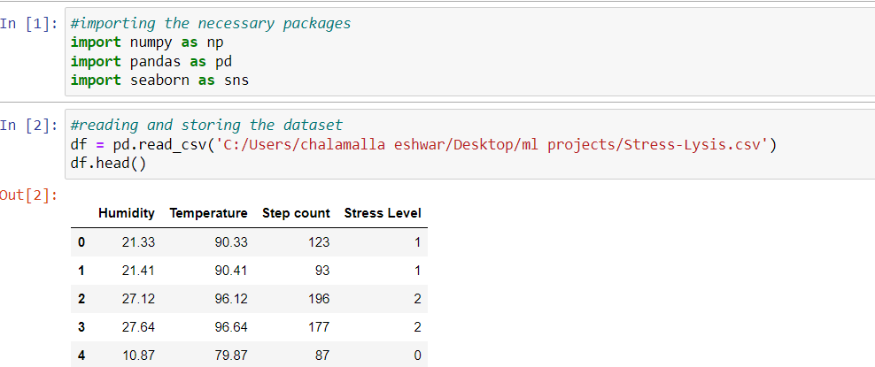
1.Preprocessing
Preprocessing is a crucial step in the machine learning pipeline that involves preparing the data for the model. It typically includes a combination of cleaning, transforming, and normalizing the data. The specific preprocessing steps will vary depending on the dataset and the model
Import the data and check for the inconsistent data

Slide 5
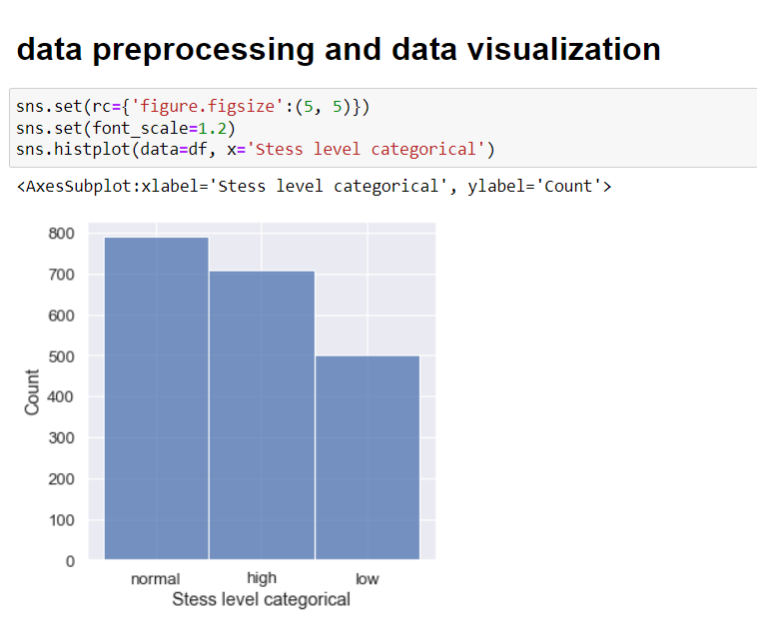
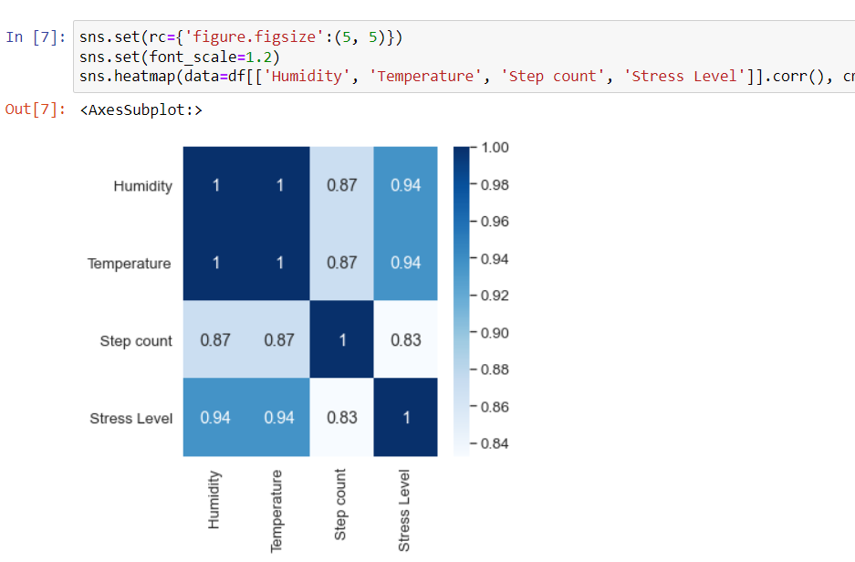
2.Data Visualization
Data visualization is the process of creating graphical representations of data in order to make it easier to understand and interpret. Data visualization can be used to explore and analyze data, to communicate insights, or to present results

Slide 6
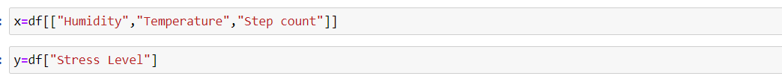
Training and Implementation Of SVM
We are using a dataset called Stress-Lysis.csv which consists of attributes. Humidity, Temperature, Step count, Stress Level We will be predicting the Stress Level using SVM.
1. Read the data attributes in x variable except the class attribute and class attribute in y variable:

Slide 7
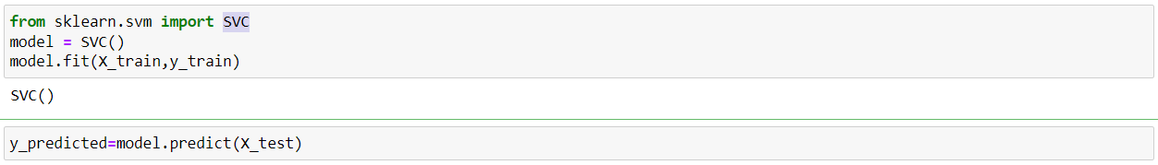
2.Import necessary packages and splitting data into testing and training with a test size of 0.2
3.create an instance of SVC python object and then fit the data and Generating predictions for our model

Slide 8
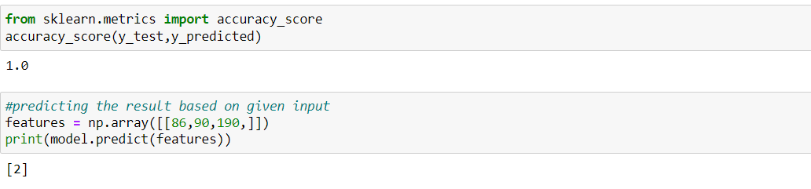
4.Finding the Accuracy of the model by comparing the predicted result and test result
And Now we will test the performance of the model by giving inputs to the model based on
the features they used to train it which means Passing the unknown values to the model which predicts the class label

Slide 9


